Slide 1
Robotics Triathlon
By: Ziv, Lucas, and Conor

Slide 2
Team Member Roles
Ziv(Problem Solver) - Wrote the algorithm for the sprints, filmed the robot, and reviewed SSD
Conor(Recorder) - Filled out SSD and completed the Gantt chart
Lucas(Coder) - Designed the Block code and made the Flow chart

Slide 3
Challenges Faced
Over the course of these robotics challenges our group faced a few problems:
Programming Issues
Sometimes we could not find block code that would do exactly what we wanted
Technical Challenges
The robot did not always go in a straight line and would wobble when moving
Robot didn’t always work
Robot would die sometimes while testing
Environmental Adaptability
The floor was not always flat and caused the robot to get messed up or wobble
Test environment was not always available
Testing
Many tests were required to get the robot to complete the sprints accurately
Time consuming

Slide 4
What we would do differently
Complete the sprints sooner rather than last minute
Fill out SSD as we go through the project rather than all at once
Make sure the robot was always charged before meeting to test

Slide 5
What we have learned about software engineering
Communication is crucial to success
Having good time management is required to complete projects on time
Dividing work between group members makes the project easier to manage and more efficient

Slide 6
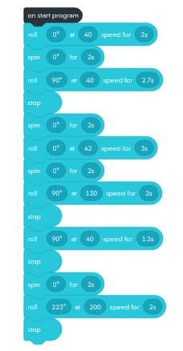
Block Code for Sprint 3- Agility

Slide 7
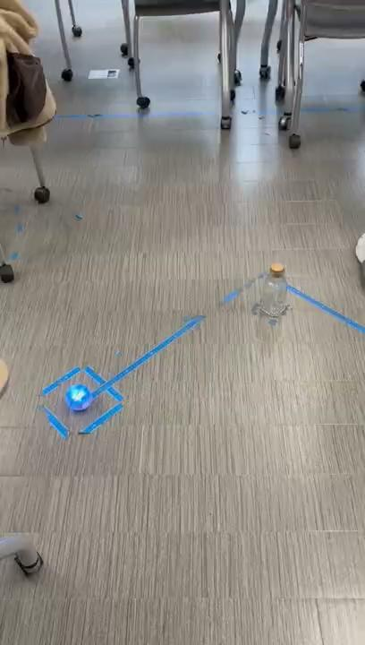
Sprint 3- Agility Video

